Slide 1
SECURE DATA HIDING IN IMAGES USING STEGANOGRAPHY
Presented By: Disha Saliyan
College Name: Srinivas Institue Of Technology Valachil, Mangalore.
Department: Computer Science and Business Systems

Slide 2
OUTLINE
Problem Statement
Technology used
Wow factor
End users
Result
Conclusion
Git-hub Link
Future scope

Slide 3
Problem Statement
Developing a secure data-hiding technique in images using steganography requires ensuring high imperceptibility, robustness, and encryption strength. The challenge is to embed sensitive information within digital images while maintaining image quality and resisting steganalysis attacks. This research aims to design an efficient, secure, and reversible steganographic method that balances payload capacity, security, and computational efficiency.

Slide 4
Technology used
Programming language: Python
System requirements:
Processor: intel i3
Operating system: Windows 11
Libraries: Python OpenCV

Slide 5
Wow factors
High Imperceptibility
Robust Encryption
Resistance to Steganalysis
Efficient Embedding & Extraction
High Payload Capacity
Cross-Platform Compatibility
Error Detection & Correction
Customizable Security Levels
Lightweight & Scalable

Slide 6
End users
Cybersecurity Professionals
Government & Intelligence Agencies
Journalists & Whistleblowers
Financial Institutions
Healthcare Sector

Slide 7
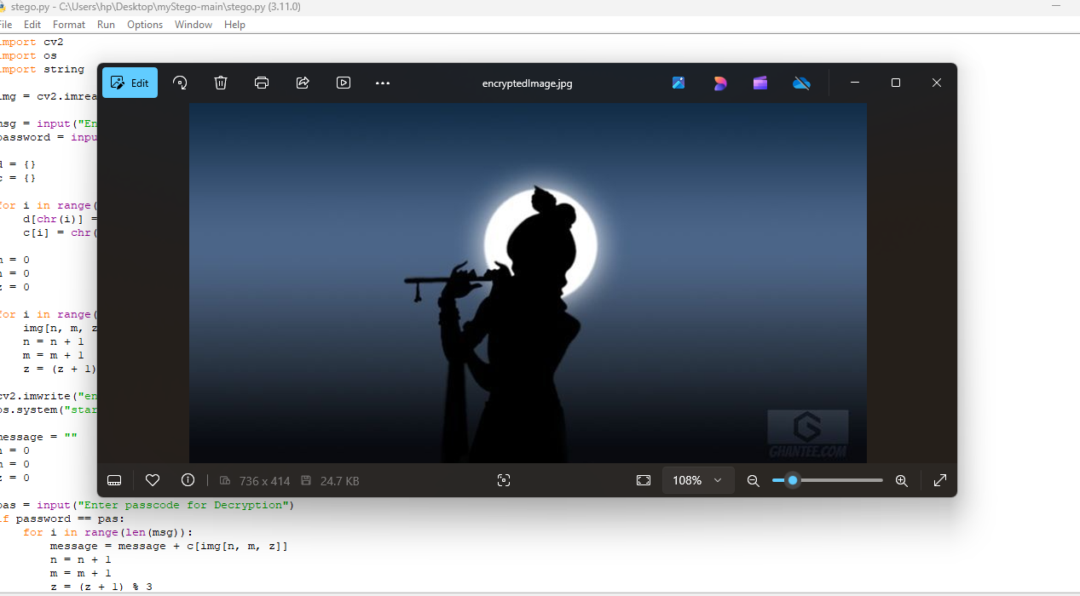
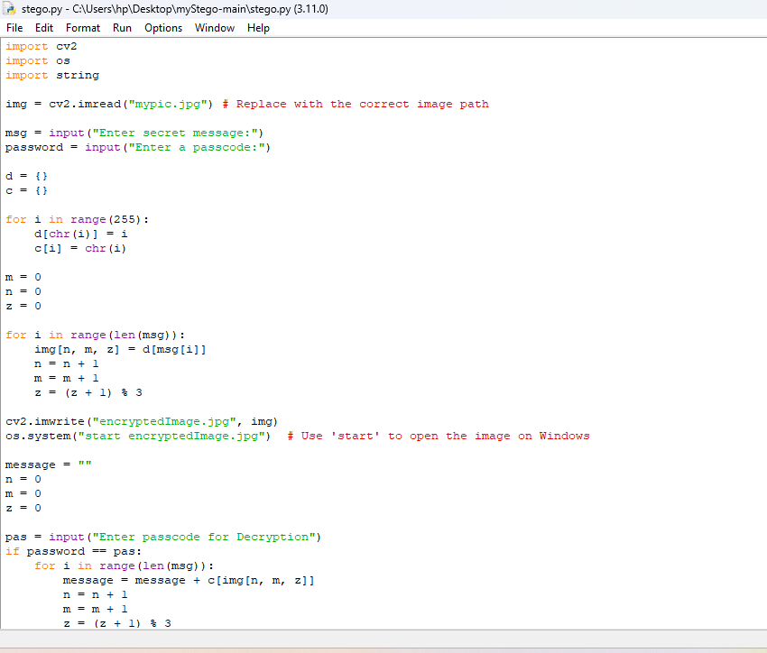
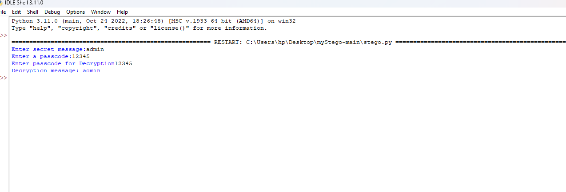
Results

Slide 8
Conclusion
Using steganography, secure data hiding in images provides an advanced method for confidential communication and data protection. By combining encryption with robust steganographic techniques, this approach ensures high imperceptibility, security, and resistance to detection. Integrating efficient algorithms and cryptographic methods enhances data confidentiality while maintaining image quality. This solution is valuable for cybersecurity, digital forensics, and secure information exchange, making it a crucial tool in protecting sensitive data against unauthorized access and cyber threats.

Slide 9
GitHub Link
https://github.com/dishasaliyan19/Secure-data-hiding-in-images-using-steganography.git
https://github.com/dishasaliyan19/Secure-data-hiding-in-images-using-steganography

Slide 10
THANK YOU

